Slide 1
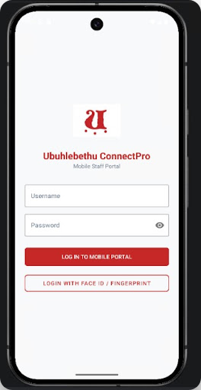
ANDROID STUDIO PROJECT SHOWCASE
Ubuhlebethu ConnectPro
Integrated Mobile Construction Management Platform for Field Workers and Site Managers
Site Operations
Real-Time Tracking

Slide 2
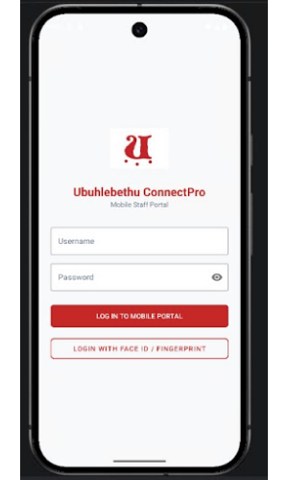
PORTAL ENTRY
Secure Mobile Portal Login
Dual Authentication Methods
Supports traditional username/password credentials alongside rapid biometric login options.
Biometric Fast Access
Integrated Face ID and Fingerprint authentication for effortless site access in active field conditions.
Role-Based Routing
Automatically routes authenticated users to Site Manager or Field Worker portals based on account permissions.

Slide 3
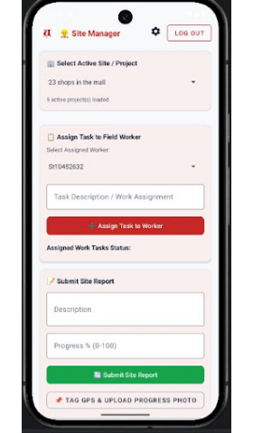
SITE MANAGER CAPABILITIES
Active Site & Task Management
Select Active Site / Project
Switch between active construction projects with live project load counts.
Assign Task to Field Worker
Select specific field workers by ID and assign structured work task descriptions.
Assigned Work Tasks Status
Monitor active assignments and real-time completion status across project teams.

Slide 4
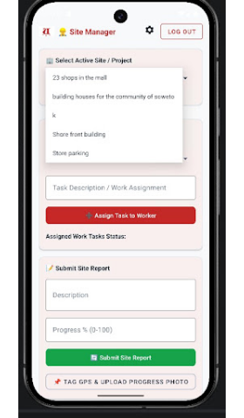
MULTI-SITE OPERATIONS
Flexible Project Switcher
Dynamic Active Projects Dropdown
Seamlessly filter data across diverse construction environments in real-time.
Commercial Development
Community Housing
e.g., "23 shops in the mall"
e.g., "building houses for community of Soweto"
Infrastructure & Waterfront
Civil Works
e.g., "Shore front building"
e.g., "Store parking"

Slide 5
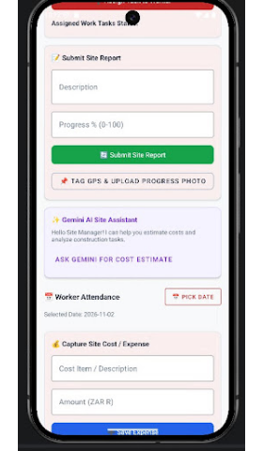
REPORTING & INTELLIGENCE
Site Reports & Gemini AI Integration
Submit Site Progress Report
Capture work progress descriptions with precise numerical percentage metrics (0–100%).
GPS Tagging & Visual Proof Upload Included
Gemini AI Site Assistant
Integrated smart assistant helping site managers estimate costs and analyze construction tasks instantly.
INTERACTIVE COST ESTIMATOR

Slide 6
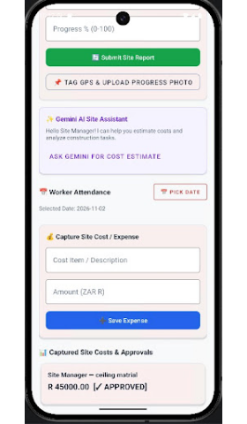
FINANCIAL & WORKFORCE CONTROL
Attendance & Cost Approvals
Worker Attendance with Date Picker
Select specific operational dates to review workforce presence on site.
Capture Site Cost / Expense
Input cost item descriptions and local currency (ZAR R) values directly from field locations.
Captured Site Costs & Approvals
Live tracking ledger showing site expenses (e.g. "ceiling material R 45000.00") with status indicators [✓ APPROVED].

Slide 7
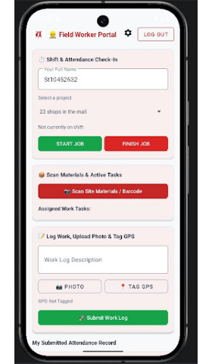
FIELD OPERATIONS
Field Worker Portal Workflow
Shift & Attendance Check-In
Simple one-tap "Start Job" and "Finish Job" triggers for precise shift time logging.
Scan Materials & Active Tasks
Integrated barcode camera scanner to track site inventory and view assigned tasks.
Log Work, Photo & GPS Tagging
Attach descriptions, photos, and exact coordinates before submitting attendance records.

Slide 8
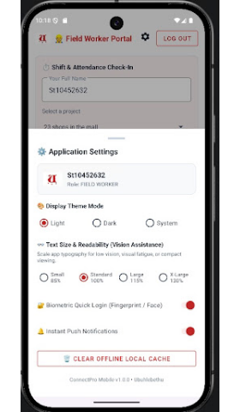
CONFIGURATION
Application Settings & Personalization
Display Theme Mode
Text Size & Readability
Toggle Light, Dark, or System themes for optimal outdoor visibility.
Vision assistance scaling (Small 85% to X-Large 130%) for high readability.
Biometrics & Notifications
Offline Local Cache Clear
Fingerprint/Face Quick Login combined with Instant Push Notifications.
One-tap local storage wipe for offline data maintenance and sync reliability.

Slide 9


SUMMARY
Platform Impact & Value
Field-Ready Tech
Role Synchronization
AI Cost Estimation
Built for tough site environments with offline cache controls, GPS tags, and barcode scanning.
Bridges the communication gap between site supervisors and field workers seamlessly.
Leverages Gemini AI for speed, accuracy, and efficiency in construction cost planning.

Slide 10


Thank You
Ubuhlebethu ConnectPro — Empowering Construction Teams Anywhere
Android Studio Project

